Slide 1
How to create right-sized test database ? Step-by-step Use Case
Jan Musil, Database Specialist, Community of Practice CEE
13. September 2013

Slide 2
Impact of Inefficient Test & Development Practices
Internally developed approaches not cost effective
  Lengthy development cycles
  Dedicated staff
  On-going maintenance
  Typically addresses needs of a single application
Lack of insight into the data environment so developers don't understand how to work with data
  Unable to comprehensively identify all dependencies before rolling change into production
Simply cloning production creates duplicate copies
  Large storage requirements and associated expenses
  Time consuming to create
  Difficult to manage on an on-going basis
Data privacy requirements are not addressed

Slide 3
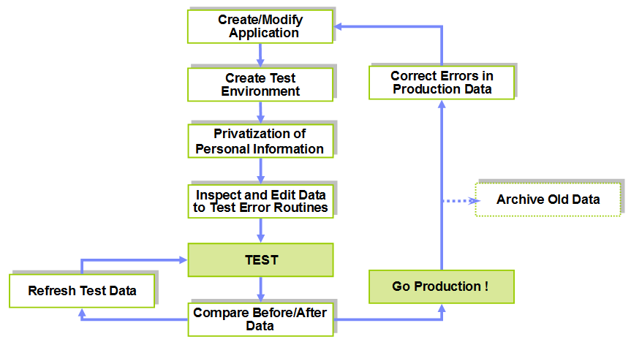
Test Data Management – Building Blocks

Slide 4
Use Case Description
Production environment consists of two databases on different platforms: custdb and orderdb
There are well documented and defined referential constraints and one relationship between databases maintained by application
The goal is to create two test databases as database schema and data subsets of the production databases
Sensitive data masking is required
  Sensitive data: customer identification, first name and last name
Customer identification defines the application relationship
  Relationship between databases should be protected even the data is deidentified

Slide 5
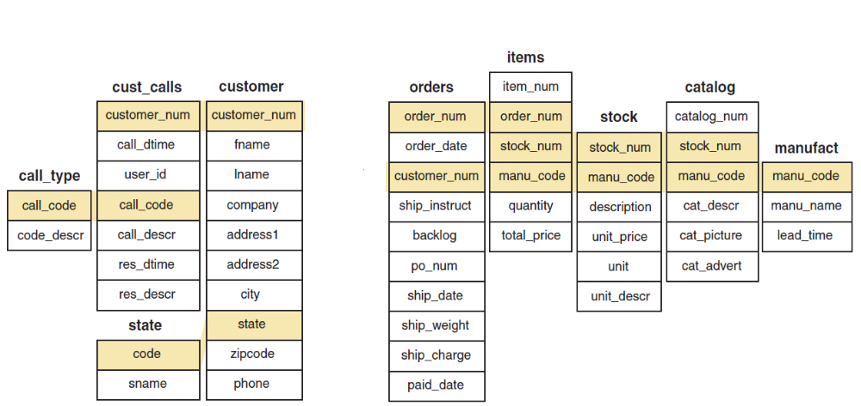

Production Environment Architecture
Database: orderdb
Platform: AIX
Database: custdb
Platform: Linux
Referential constraint
Application relationship

Slide 6
Final Test Environment Architecture
Database: orderdb_test
Platform: AIX
Database: custdb_test
Platform: Linux
Referential constraint
Application relationship

Slide 7
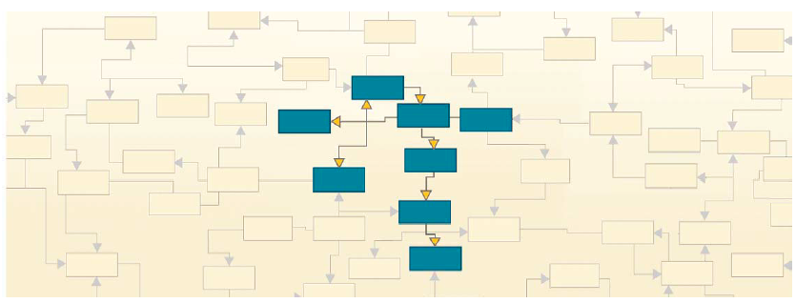
What is Business Object ?
Referentially-intact subset of data across related tables, databases, applications and systems, metadata including
Provides “historical reference snapshot” of business activity
Two perspectives:
  business perspective, a business object could be a payment, invoice, paycheck, or customer record.
  database perspective, a business object represents a group of related rows from related tables across one or more applications, together with its related “metadata” (information about the structure of the database and about the data itself).

Slide 8
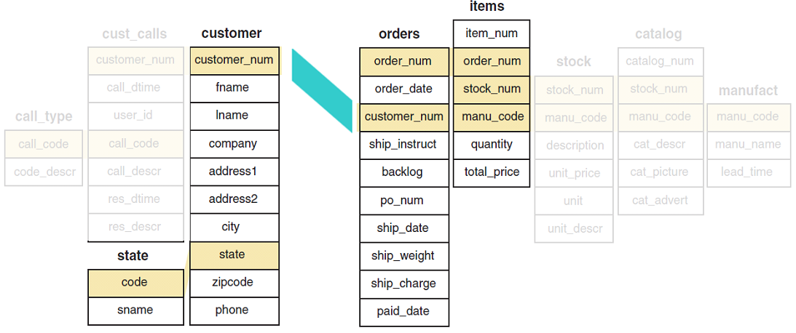
Use Case: Business Object Definition
Database Perspective:
customer table
state table
orders table
items table
Business Perspective:
order record

Slide 9
What is Relationship ?
A relationship is a defined connection between the rows of two tables that determines the parent or child rows to be processed and the order in which they are processed
Two types of relationships
  Referential constraint
    Foreign key in one table references the primary key in another table
    Parent table must have a Primary Key that is related to the Foreign Key in the child table
    Corresponding columns must have identical data types and attributes
  General relationship
    Primary Keys and Foreign Keys are not required (or are not defined)
      - Application-managed relationships
    Corresponding columns need not be identical, but must be compatible
    Can use an expression to evaluate or define the value in the second column
      Expressions can include string literals, numeric constants, NULL, concatenation, and substrings

Slide 10
Types of Tables
Parent table
  The table must have a primary key that is related to the foreign key in the child table OR
  the table has general relationship with child table
Child table
Reference Table
  Unless selection criteria are specified for the table, all rows are selected from the table.

Slide 11
Use Case: Relationships Definition
General relationship:
customer: Parent table
orders: Child table
Referential constraint:
orders: Parent table
items: Child table
Referential constraint:
state: Reference table
We finished
database schema subset
definition

Slide 12
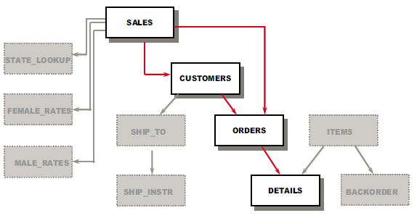
What is Traversal Path ?
Determines the sequence in which an process selects data from tables
Select the relationships to be used and the direction in which the relationships are traversed:
  from parent to child
  from child to parent
  or in both directions
Define the traversal path after selecting the tables and specifying selection criteria for the data
During the processing, normal traversal of relationships paths proceed like a waterfall through a data model.

Slide 13

Traversal options
Waterfall (top-down)
  Follows relationships automatically from parent to child
Reverse waterfall
  Follows relationships optionally from child to select parent rows
More data
  Follows relationships optionally from parent rows selected in a reverse waterfall flow to select child rows that have not been selected previously

Slide 14
Use Case: Data Subset Selection
Select orders older then 1.7.2013 for first 10 customers
Table size limit:
order_date < “1.7.2013“
Table size limit:
customer_num<111

Slide 15
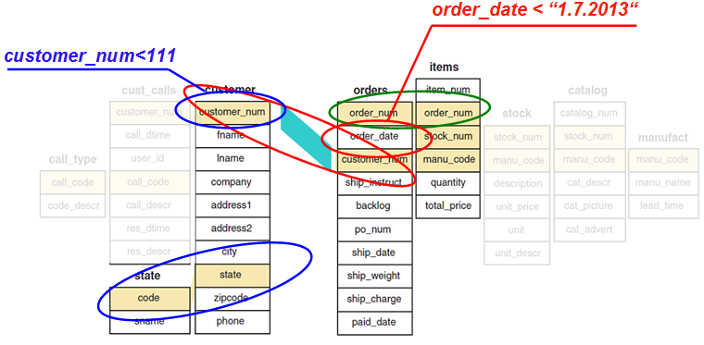
Use Case: Extract steps
Step 1:
  Extract Rows from table orders. Selection Criteria order_date<“1.7.2013“ are used
Step 2:
  Extract Rows from customer which are Children of Rows Previously Extracted from orders in Step 1 using Relationship ORDERS_CUST Limited by Selection Criteria customer_num<111.
Step 3:
  Extract Rows from items which are Children of Rows Previously Extracted from orders in Step 1 using Relationship r105_11.
Reference Table(s):
  state
    All Rows

Slide 16
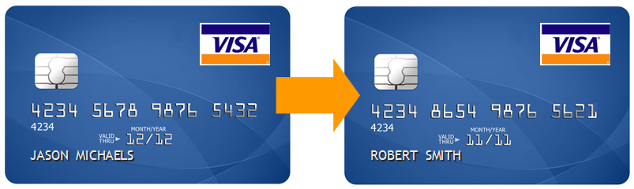
What is Data Privacy ?
Data Privacy (masking, de-identification) provides a comprehensive set of data masking techniques to transform or de-identify sensitive data:
  String literal values
  Character substrings
  Random or sequential numbers
  Arithmetic expressions
  Concatenated expressions
  Date aging
  Lookup values
  Intelligence

Slide 17
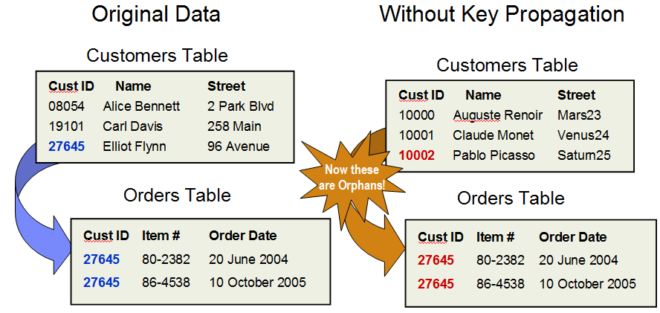
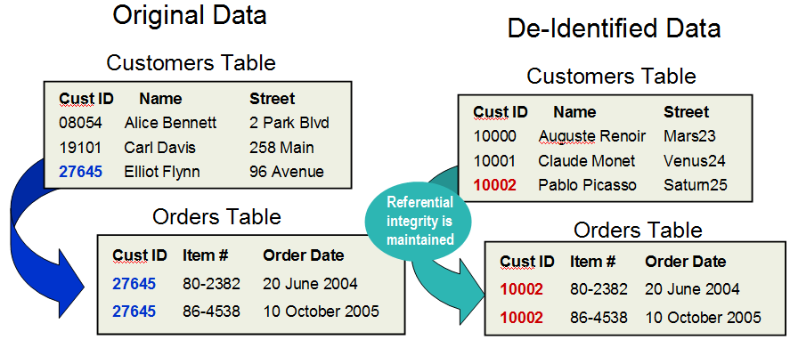
What is Key Propagation ?
Data is masked with contextually correct data to preserve integrity of test data and referential integrity is maintained with key propagation.

Slide 18
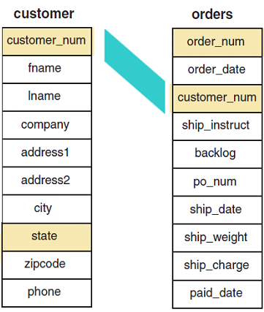
Use Case: Personal Data Masking and Key Propagation
Data Masking Technique with propagation
Sequential number
Data Masking Technique
Lookup values

Slide 19
Business Benefits of Test Data Management
More time for testing
  30-40% of test script execution is spent on manufacturing new test data.
  Test data management will reduce the amount of time spent creating new data thereby allowing for the execution of more tests
Increase data quality
  Refreshing test data from a baseline will minimize the amount of manual intervention currently required when creating new test data reducing triaging efforts and increasing test repeatability
Enforce data ownership
  Often the “honor system” and spreadsheets are used to control test data ownership.
  Test data management offers role driven security to support level segmentation of the development and testing teams
Reduce data dependencies across test sets
  Multiple test sets often use the same data, but different tests can negatively impact other tests using the same data.
  Test data management allows for the creation of an unlimited number of test data sets and can create unique ID’s each time to ensue clean data is used when testing

Slide 20
Practical Demonstration

Slide 21
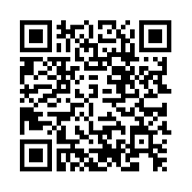
Thank You
Jan Musil
jan_musil@cz.ibm.com

